Slide 1
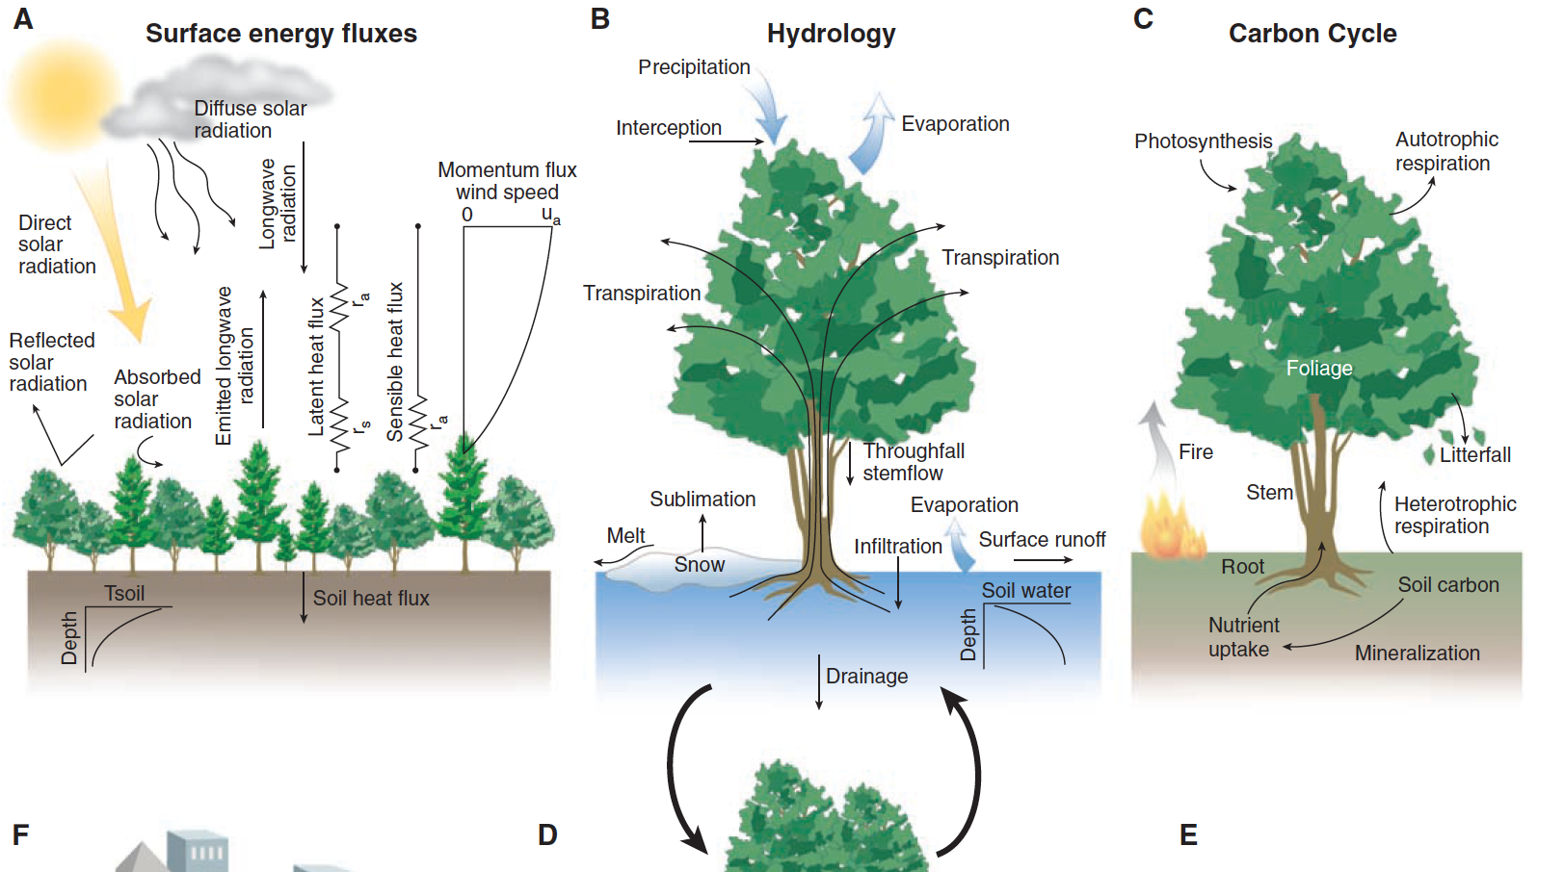
Introduction to G481/581: Terrestrial Ecosystem Modeling
Instructor: Dr Natasha MacBean

Slide 2
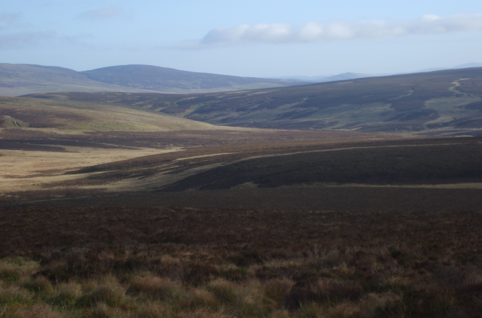



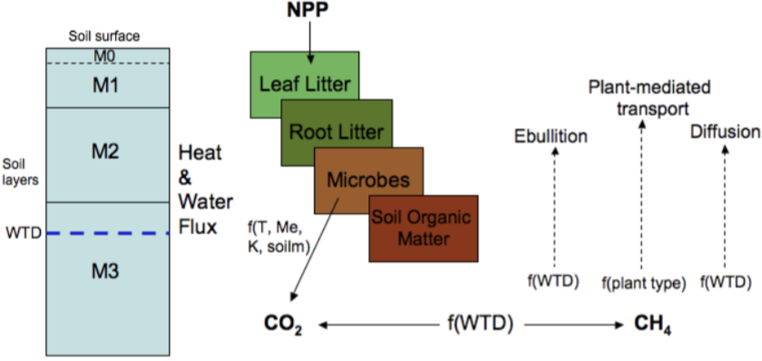
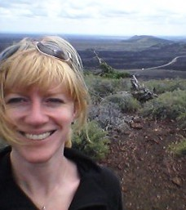
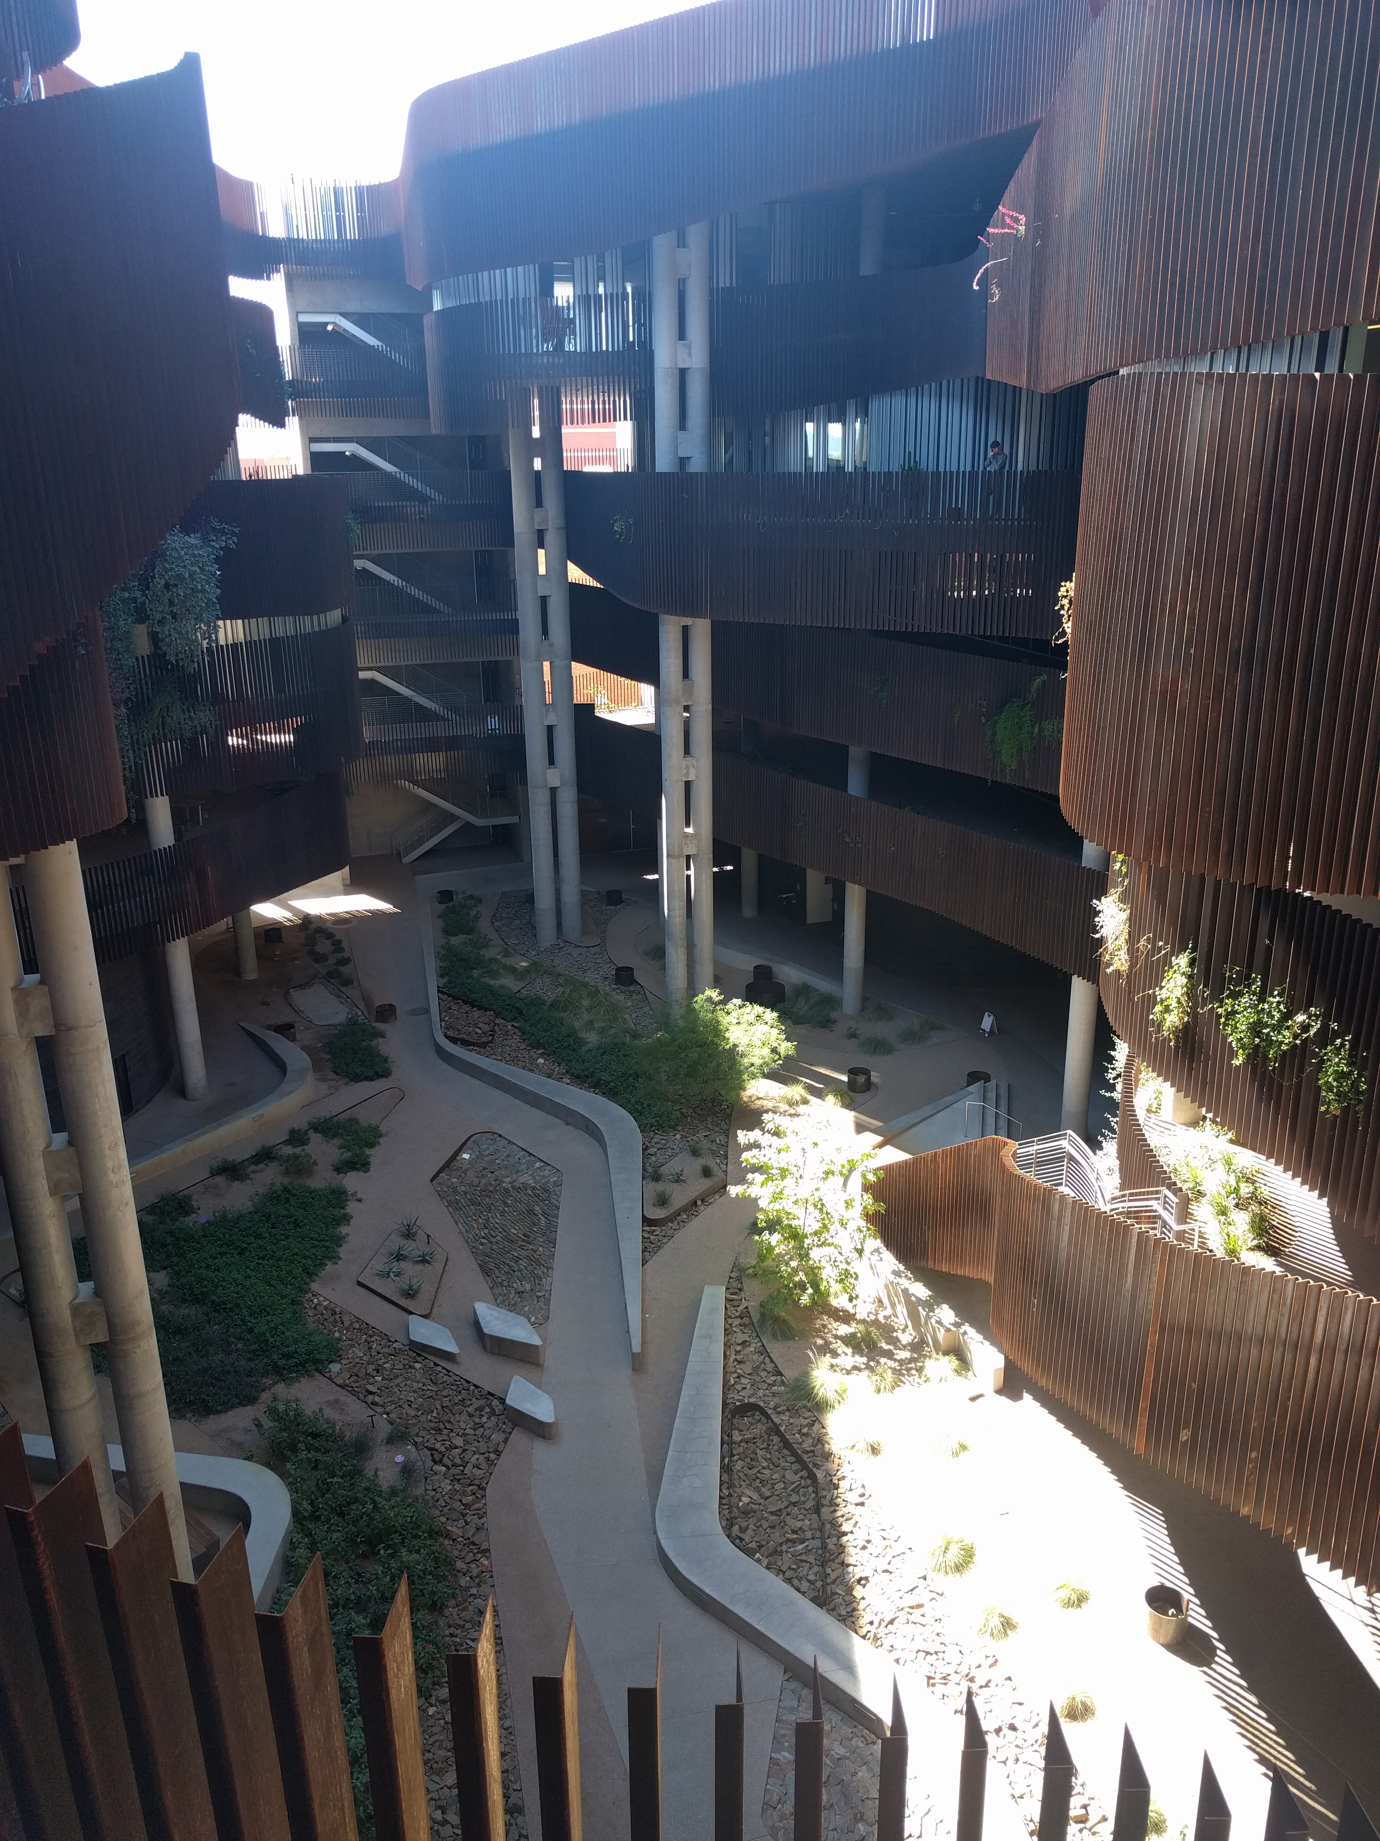

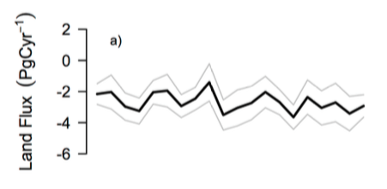
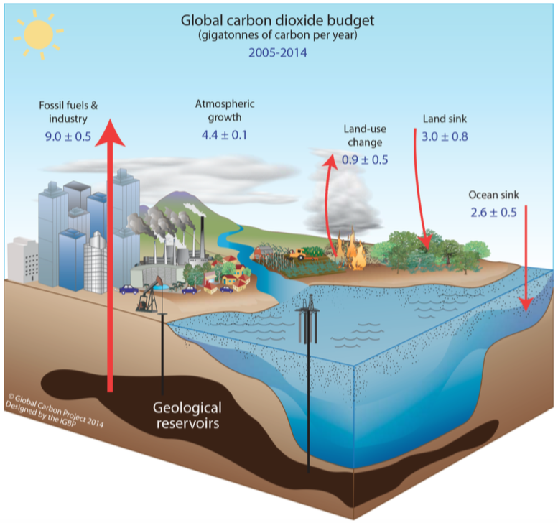
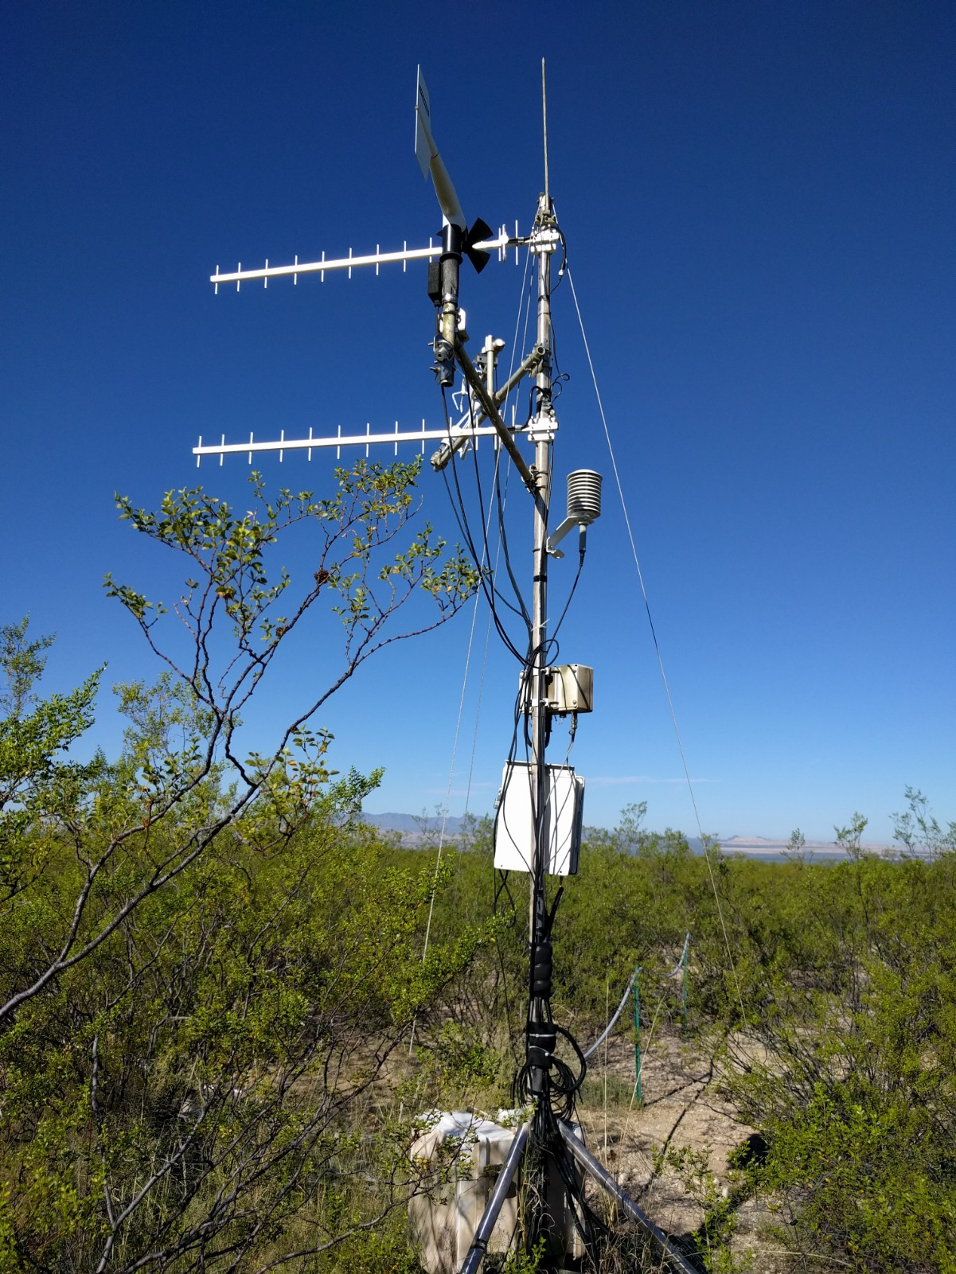
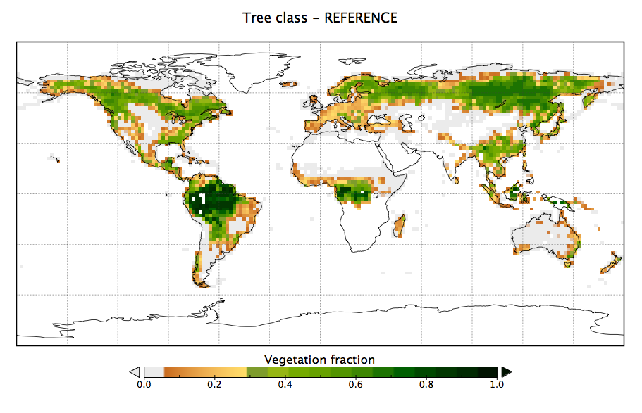
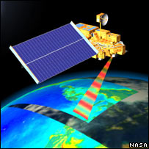
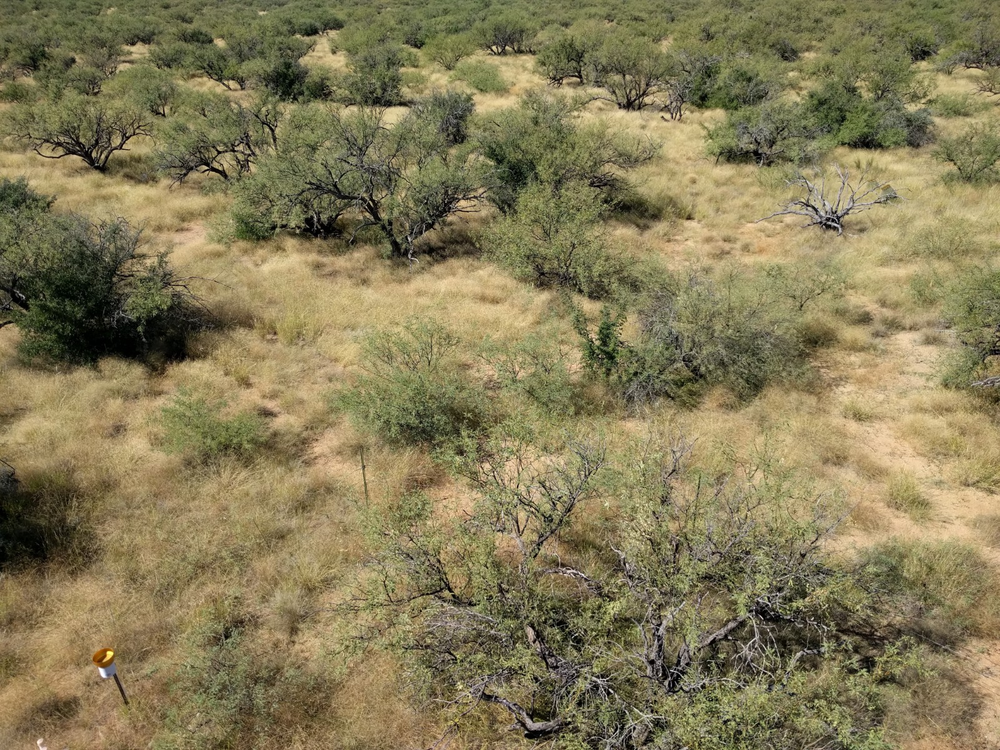
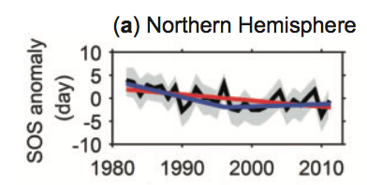


Mini biography and research
Research: Terrestrial ecosystem responses to global environmental change and feedbacks to climate:
https://macbeanlab.com
PhD
Modeling peatland CH₄ fluxes
Data assimilation
Global C cycle + data assimilation
MODIS
Land cover mapping + change
Trends in vegetation dynamics
Semi-arid ecosystems

Slide 3
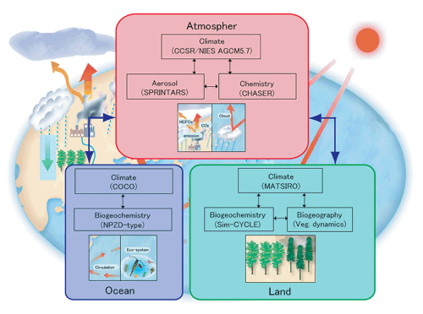
What is a Terrestrial Ecosystem Model?
The land component of an earth system model
Terrestrial ecosystems and physical, chemical and biological processes
Contains hydrology, energy, biogeochemical cycles (i.e. carbon), human activities
Global scale
Used for historical and future projections
Developed from a range of fields
https://www.jamstec.go.jp/kakushin21/eng/team1.html
https://www.carbonbrief.org/qa-how-do-climate-models-work
Notes:
“At their most basic level, climate models use equations to represent the processes and interactions that drive the Earth’s climate. These cover the atmosphere, oceans, land and ice-covered regions of the planet. The models are based on the same laws and equations that underpin scientists’ understanding of the physical, chemical and biological mechanisms going on in the Earth system. Scientists translate each of these physical principles into equations that make up line after line of computer code – often running to more than a million lines for a global climate model.”
(https://www.carbonbrief.org/qa-how-do-climate-models-work)

Slide 4
Other ways we refer to TEMs
Land Surface Models (LSMs)
Terrestrial Biosphere Models (TBMs)
Dynamic (Global) Vegetation Models (DVMs or DGVMs)
Related to their historical development vs current use
→ We will learn about the differences and similarities on Wednesday

Slide 5
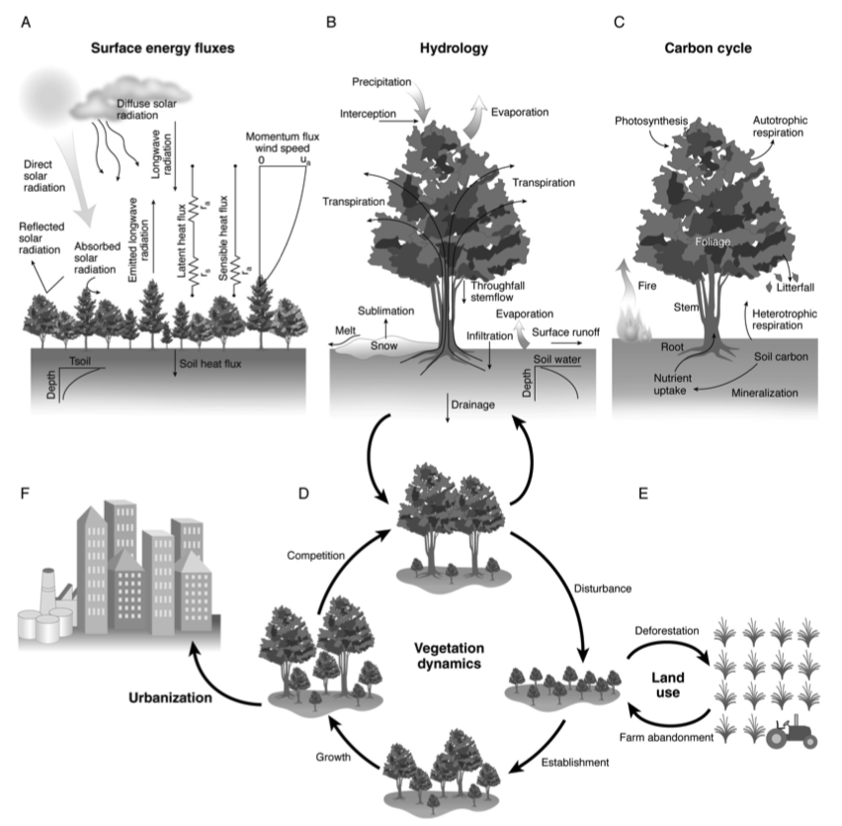
What’s in a TEM?
Bonan, 2019

Slide 6
What are TEMs used for?
Test ecosystem behavior beyond measurements (in both space and time)
Contains our best knowledge of how interacting systems and processes work.
Response of terrestrial ecosystems to changing climate, rising CO₂ and land use/cover change and management
“Feedbacks” of these terrestrial responses to the climate → influences future climate projections
Short-term: land-atmosphere feedbacks
Longer-term: carbon-climate feedbacks
Can test future “scenarios” of human impacts on biosphere and climate
Can test hypotheses of our process understanding
Research tool to guide data collection

Slide 7
Why study terrestrial ecosystem modeling?
Better understand:
what is in these models
how mathematical models work → simplifications of real-world processes
advantages and limitations of the models
how TEMs fit within earth system models
IPCC climate change projections/reports and impact assessments
latest model experiments → will be in the news a lot over next few years
link to your work/research

Slide 8
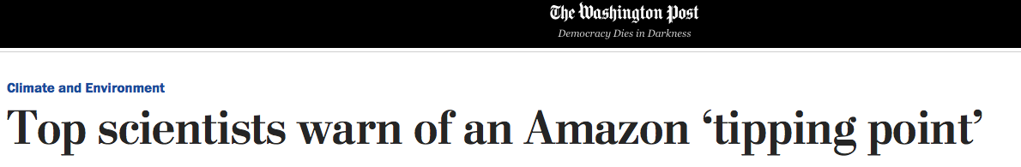
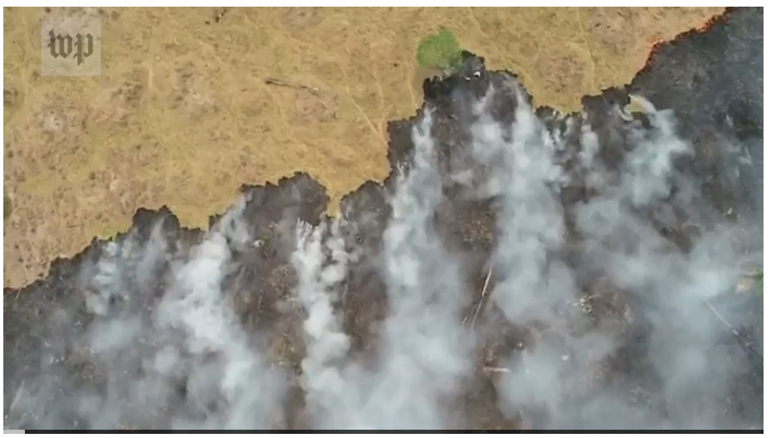
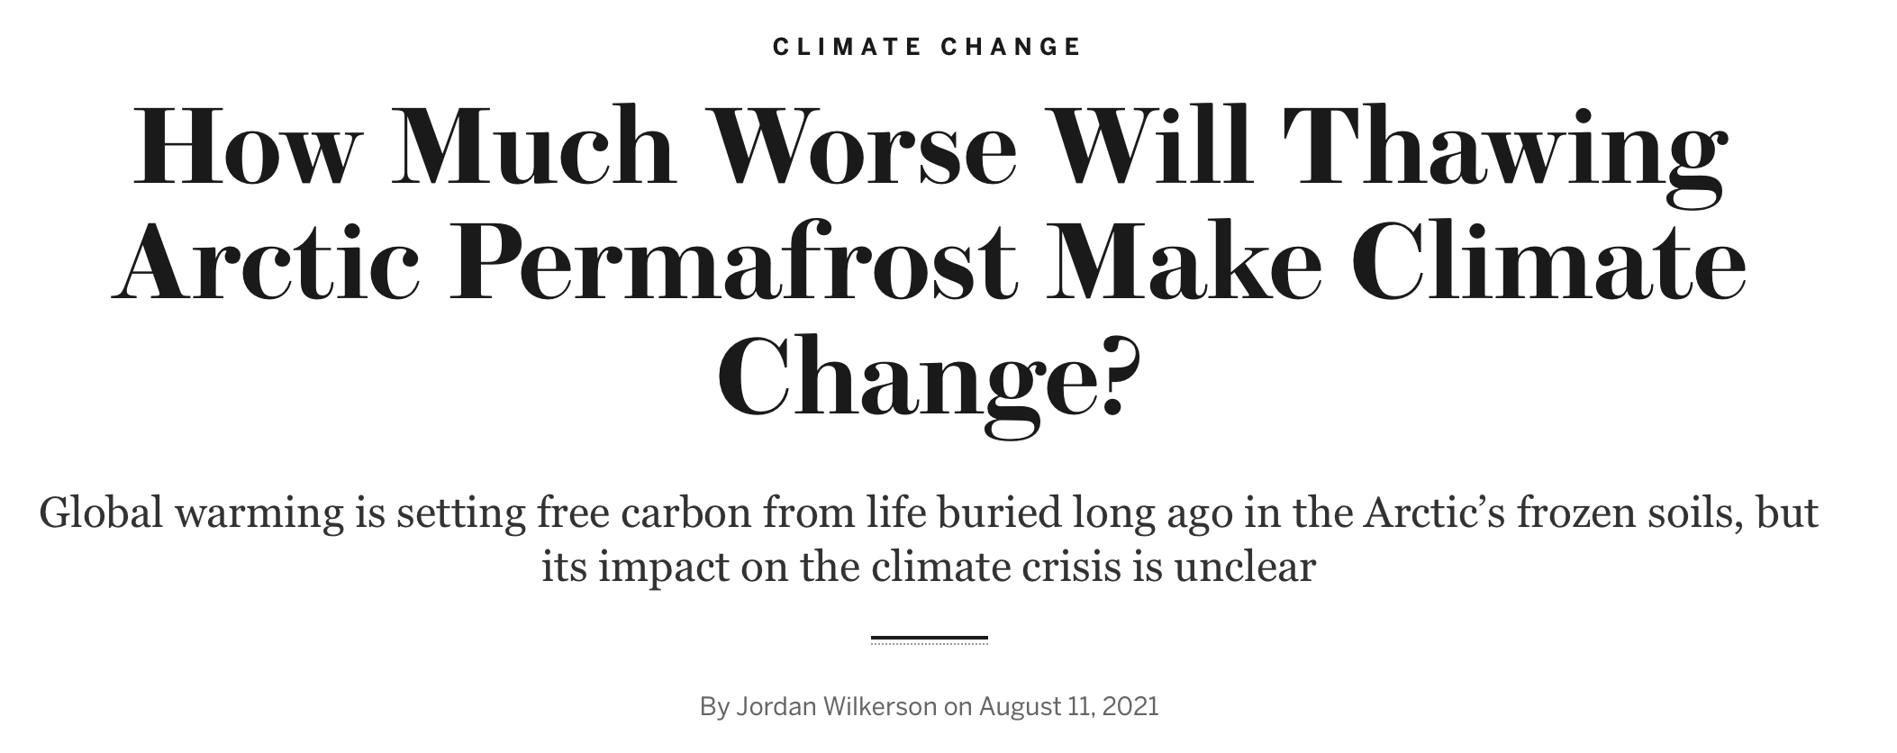
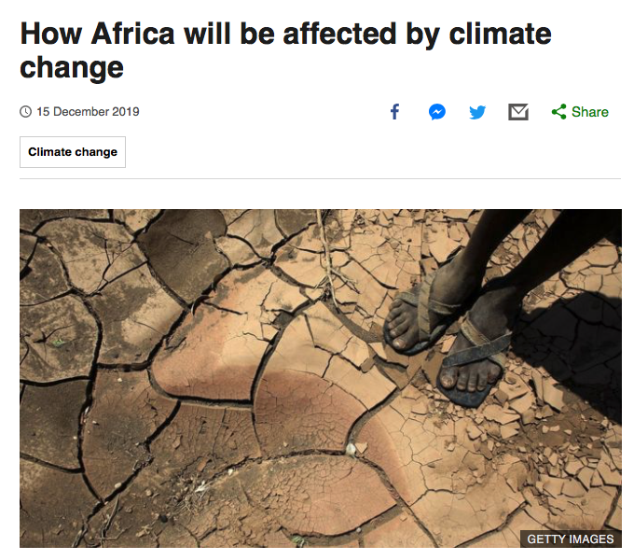
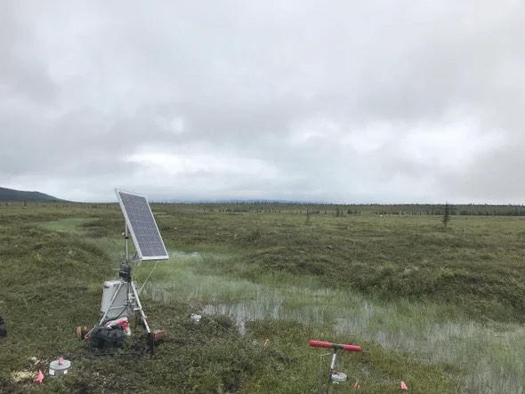
TEMs in the news…

Slide 9
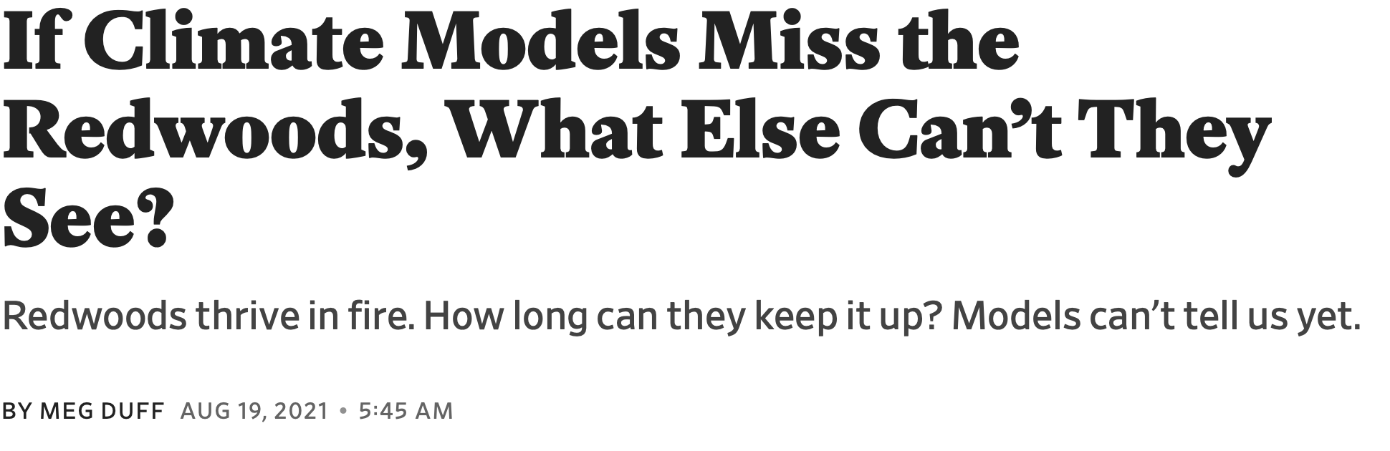

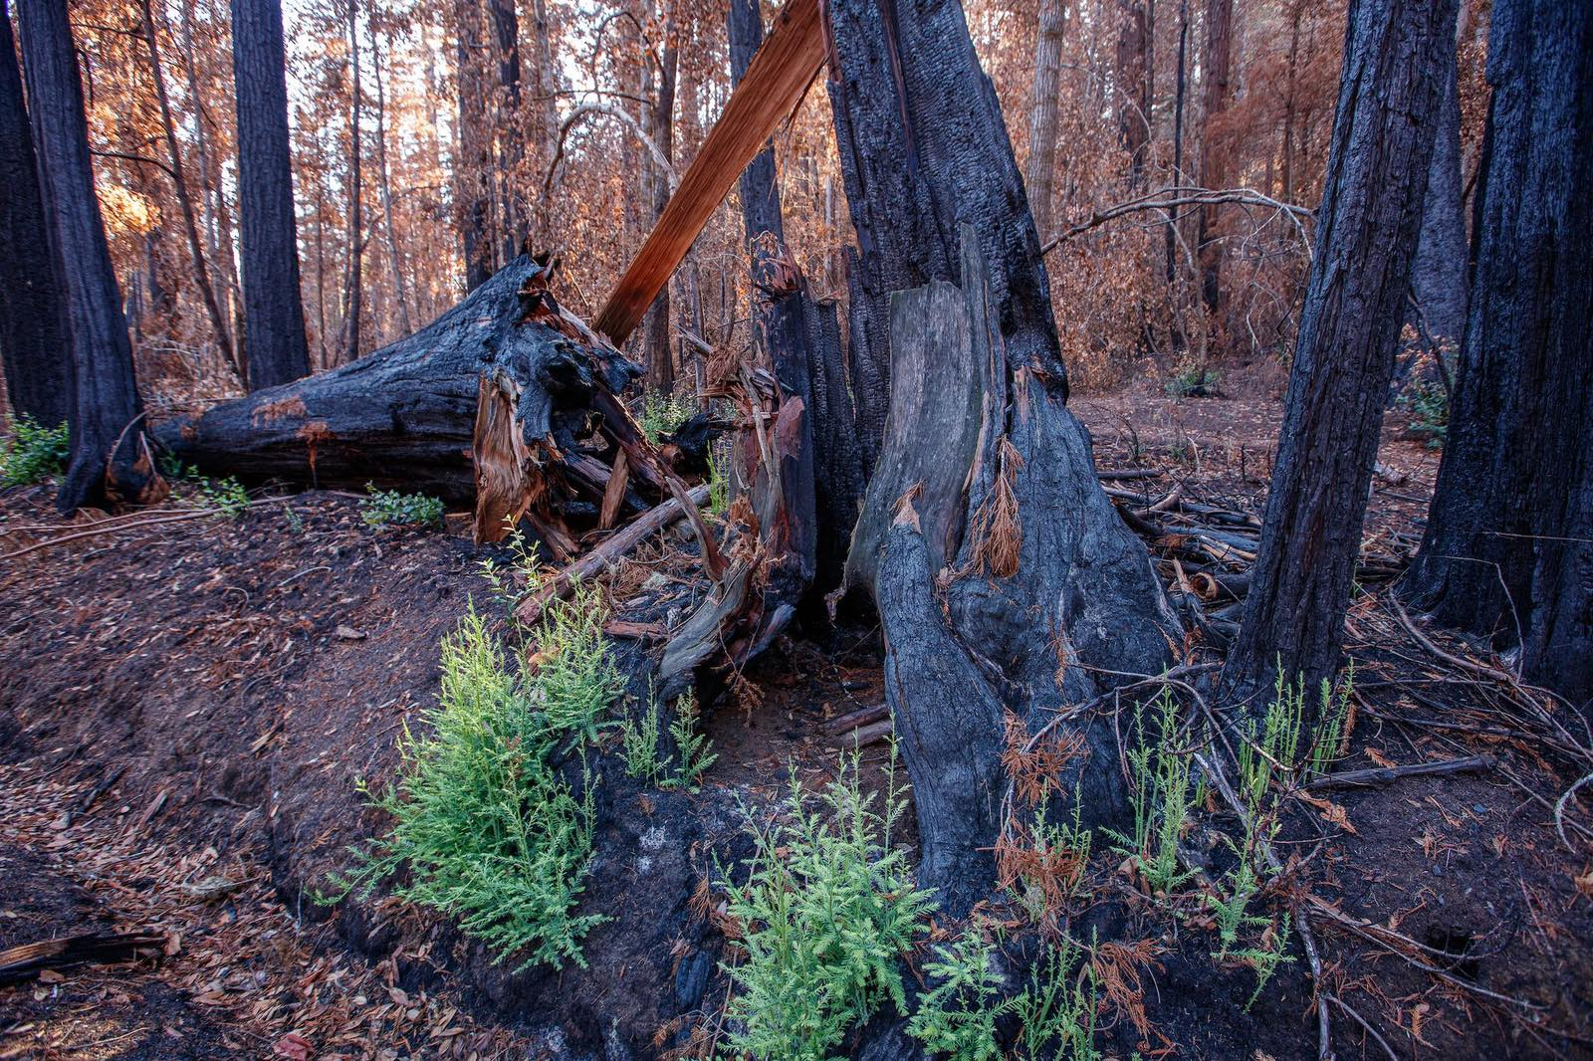
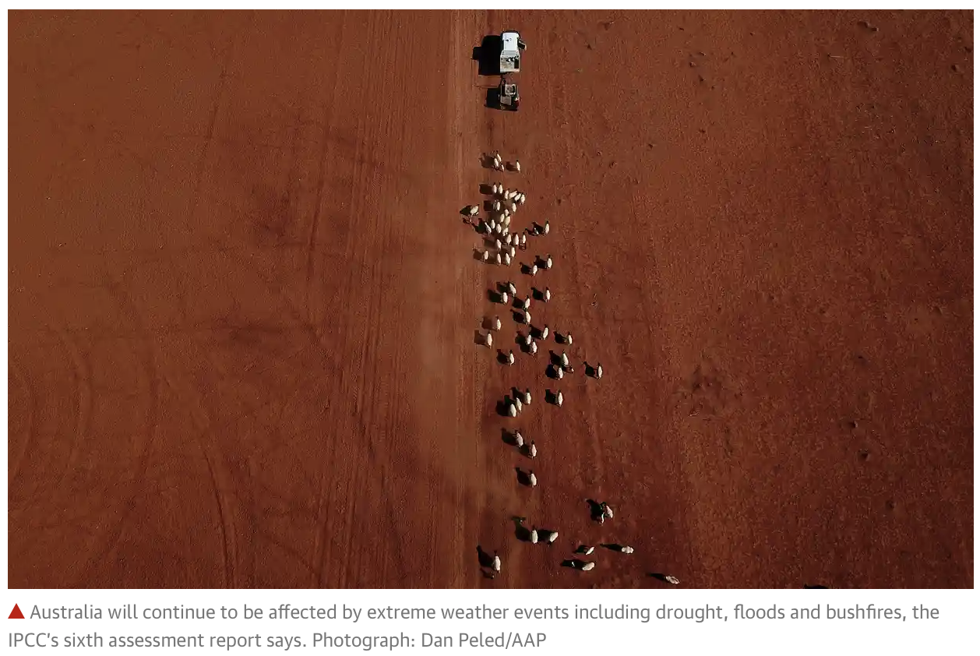
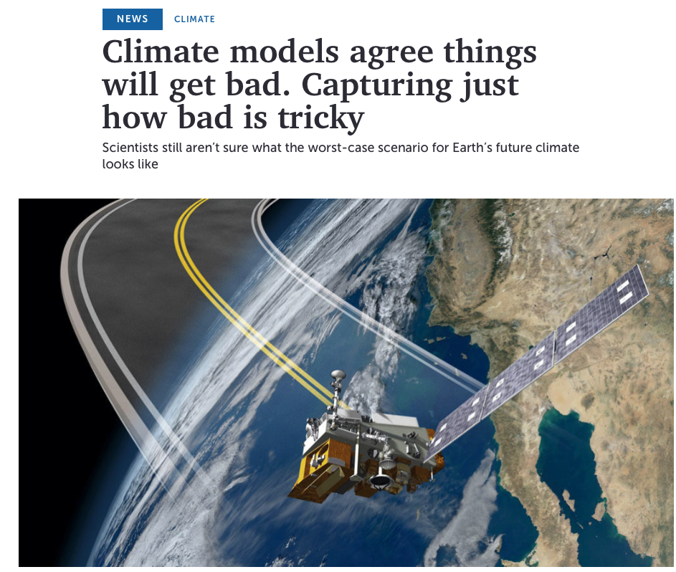
TEMs in the news…

Slide 10
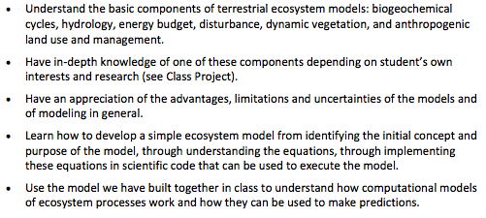
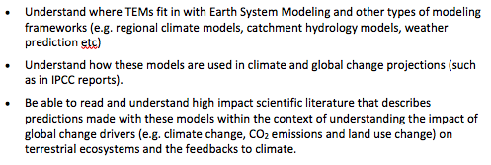
Learning Outcomes

Slide 11
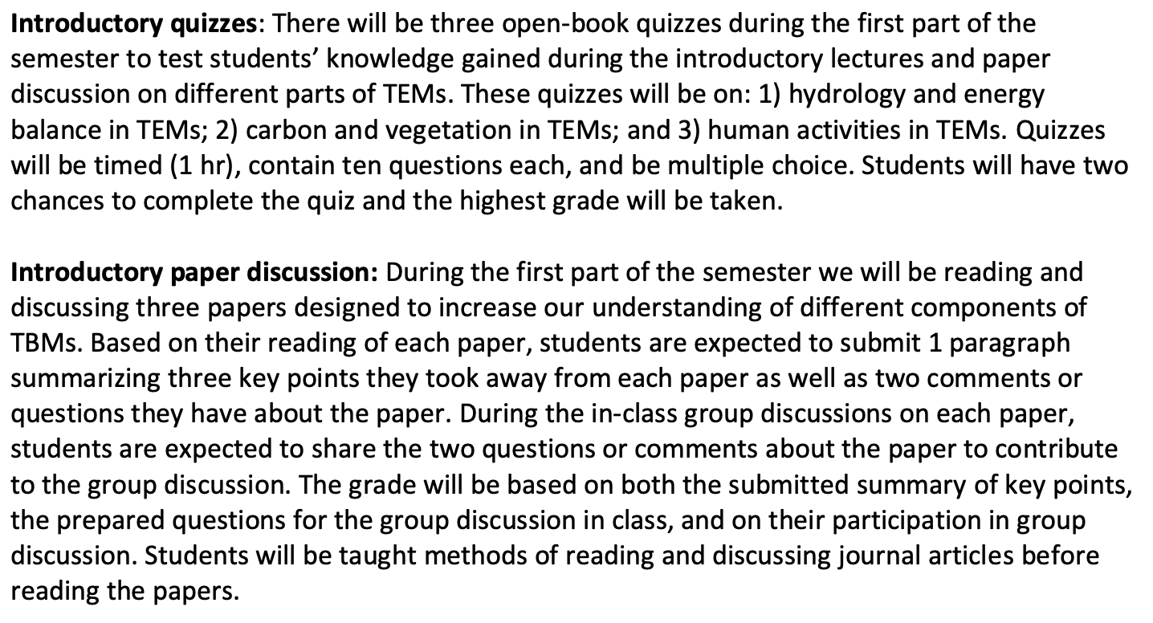
Course format – 1st part

Slide 12
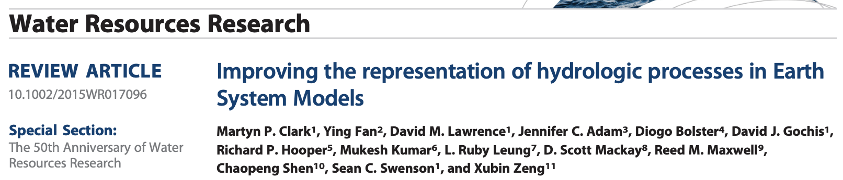

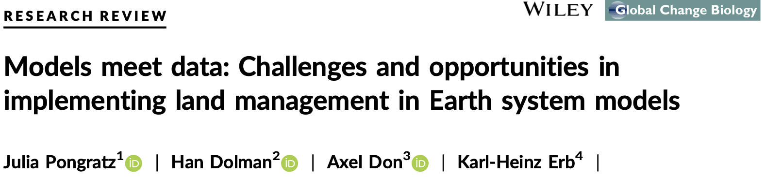
Introductory paper discussion

Slide 13
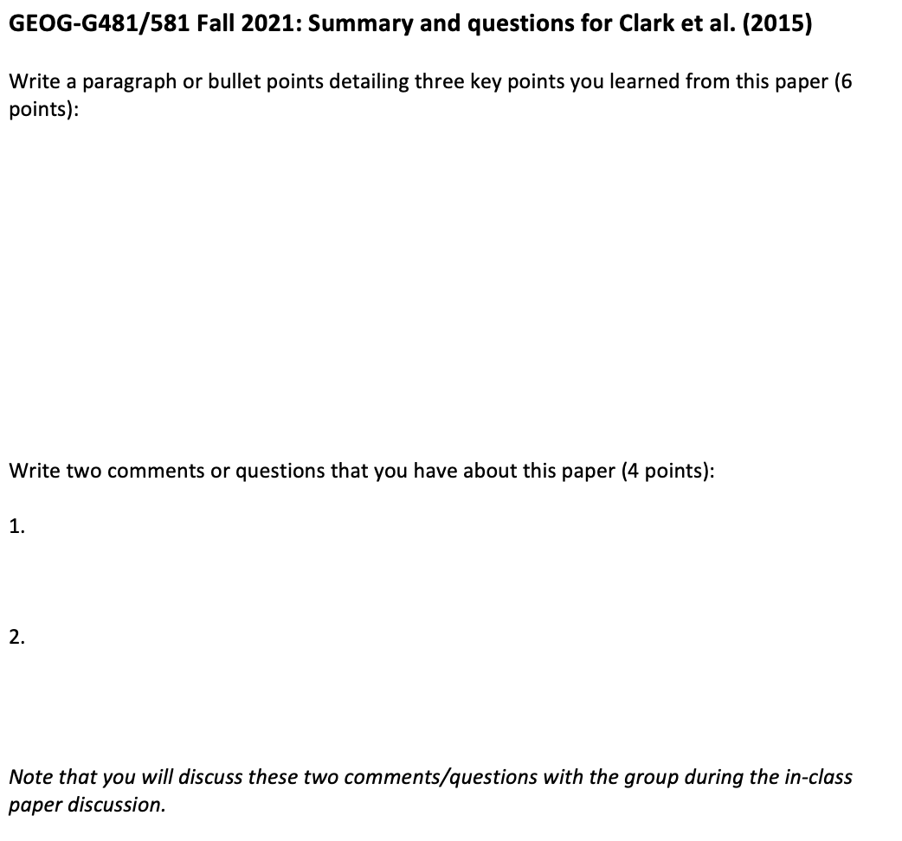
Introductory paper discussion
Notes:
Expecting grad students to be at a higher level.

Slide 14
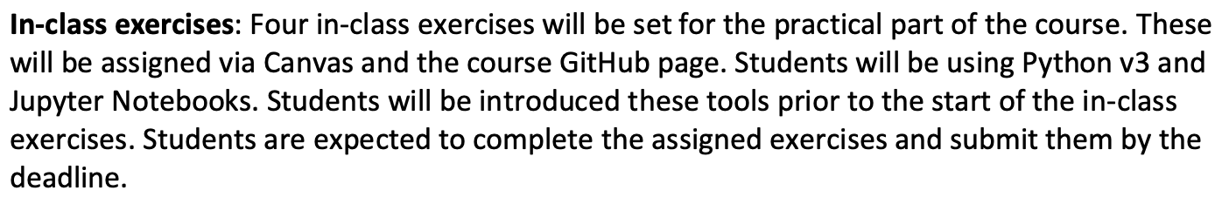
Course format – 2nd part
Who has access to a laptop that they can bring to class?

Slide 15
In-class exercises
Building a simple carbon and hydrology model
Model inputs and outputs
Sensitivity tests
Model evaluation
In python and jupyter notebooks (but don’t need to know programming)
Comprehension questions at the end of each exercise

Slide 16
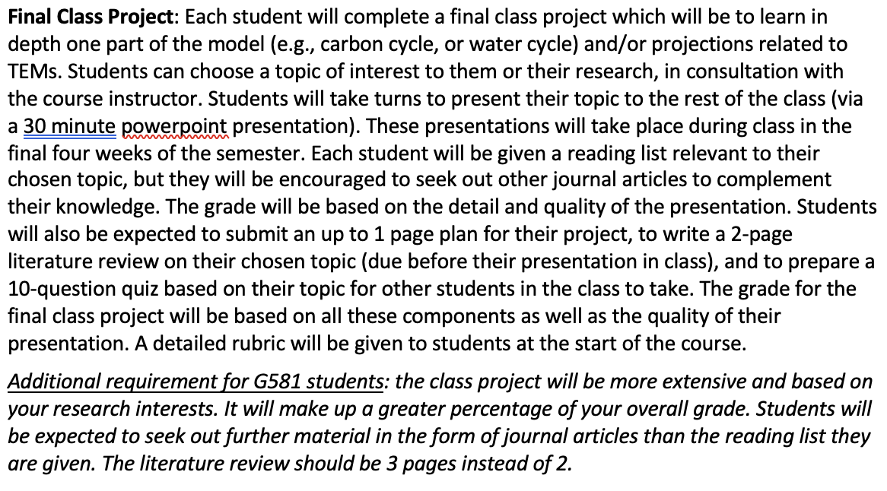
Course format – 3rd part

Slide 17
Class Project
Put together a powerpoint presentation (~30 minutes) focusing in detail on a specific aspect of TEMs → you will present this to the rest of the class.
Plus a 2-3 page literature review covering the material you cover in your presentation.
10 question Quiz for rest of the class
Plan for topics/references you will cover due end Week 7.
Reading list to you by end of Monday Week 8.
All topics will have been introduced briefly in the first quarter of the course.
Most topics covered in course textbook, but supplementary readings will be supplied (graduate students also expected to expand literature search on their own).
Presentation will include:
How your chosen topic (model process(es)) are represented in TEMs - overview of calculations involved and different ways processes are implemented in different models.
Why it’s important for modeling climate and ecosystem response to global change?
Advantages/disadvantages/caveats/uncertainties of how chosen topic is represented in models
Address all the learning outcomes for the course.

Slide 18
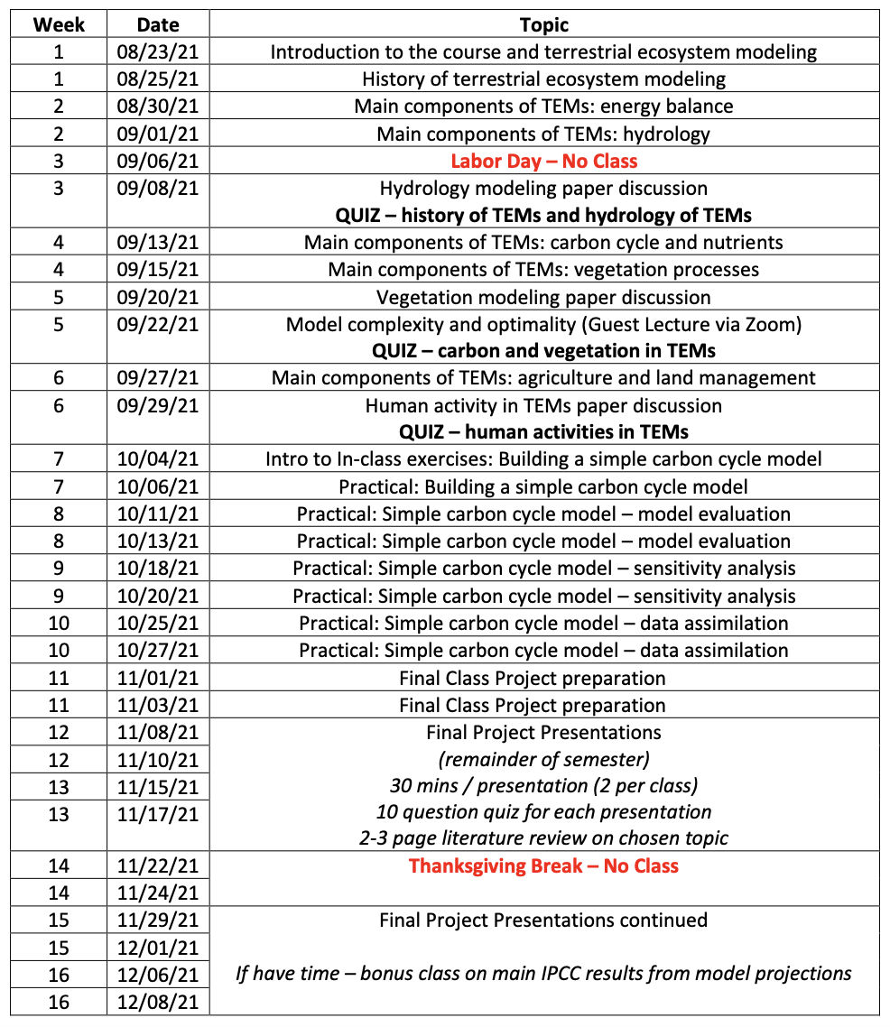
Schedule

Slide 19
Class Project: possible topics
Impacts of climate change at ecosystem to global scales
Impacts of rising CO₂
Impacts of changing water availability/streamflow
Modeling disturbance (fires, insect outbreaks, etc)
More in depth on biogeochemical models: how to model carbon allocation, soil microbial processes, photosynthesis, phenology, nutrient limitations, etc.
More in depth on hydrology models: Snow modeling; spatial hydrology modeling, etc.
Dynamic vegetation modeling (species competition etc)
Model evaluation and inter-comparison studies (for a particular region or model component)

Slide 20

Reading scientific journal articles (papers) for the in-class project

Slide 21
Course format
No exam – quizzes are open-book.
Learn from introductory lectures and in-class exercises so you can have the knowledge to go on to understand your “in-depth” topic for the class project.

Slide 22
Course format
No exam – quizzes are open-book.
Learn from introductory lectures and in-class exercises so you can have the knowledge to go on to understand your “in-depth” topic for the class project.
Key take home messages of this course:
What these models contain, what their predictions are, especially within IPCC climate change projections
Challenges associated to implementing our knowledge of processes into models
Also challenges with the “known unknowns” and the “unknown unknowns” (missing processes)
Models contain uncertainty and complexity → this doesn’t mean their projections are completely wrong! Instead, we just need to have an informed and nuanced appreciation of these issues.

Slide 23
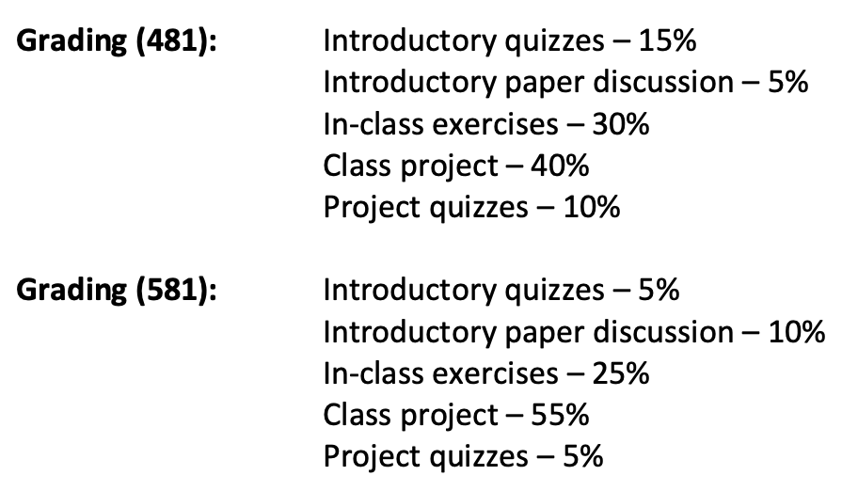
Grading breakdown

Slide 24
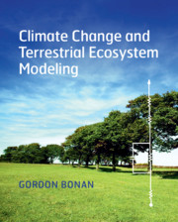
Textbook
Bonan, G. (2019) Climate Change and Terrestrial Ecosystem Modeling, 1st Edition, Cambridge University Press, UK.
Also useful: Bonan, G. (2016) Ecological Climatology: Concepts and Applications. Cambridge University Press, 3rd Edition.
Note: Introductory papers, papers for your project, and supplemental readings will be provided on Canvas.

Slide 25
Lecture slides…
Numbered
Uploaded to Canvas after each class
Participation and attendance.
Office hours
Covid and student wellness

Slide 26
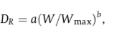
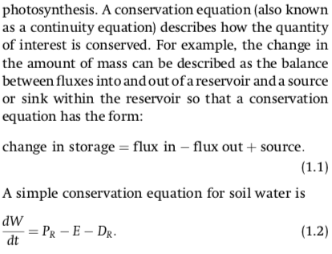
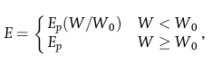
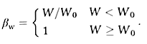
Equations! How much math do you need to know?
β_{w}
1
β_{w}
W₀ = 0.7
0
W
0
0.7
1
Notes:
Won’t just put an equation up and expect you to understand it.
Explain which parts are inputs, which are parameters, which are prognostic variables, which are model formulations/parameterizations
Will plot functions so you can see what it looks like.

Slide 27
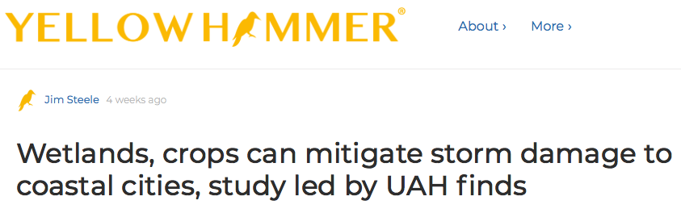
Extra credit
1 extra credit for “In the news” item related to TEMs
Present 1-3 slides at beginning of class
Max 2 extra credits per person

Slide 28
This week…
Class on Wednesday: History of terrestrial ecosystem modeling, earth system modeling, and how all this fits into the IPCC climate change reports
Meanwhile, have a read of Bonan textbook Chapter 1 (provided on Canvas)

